Slide 1
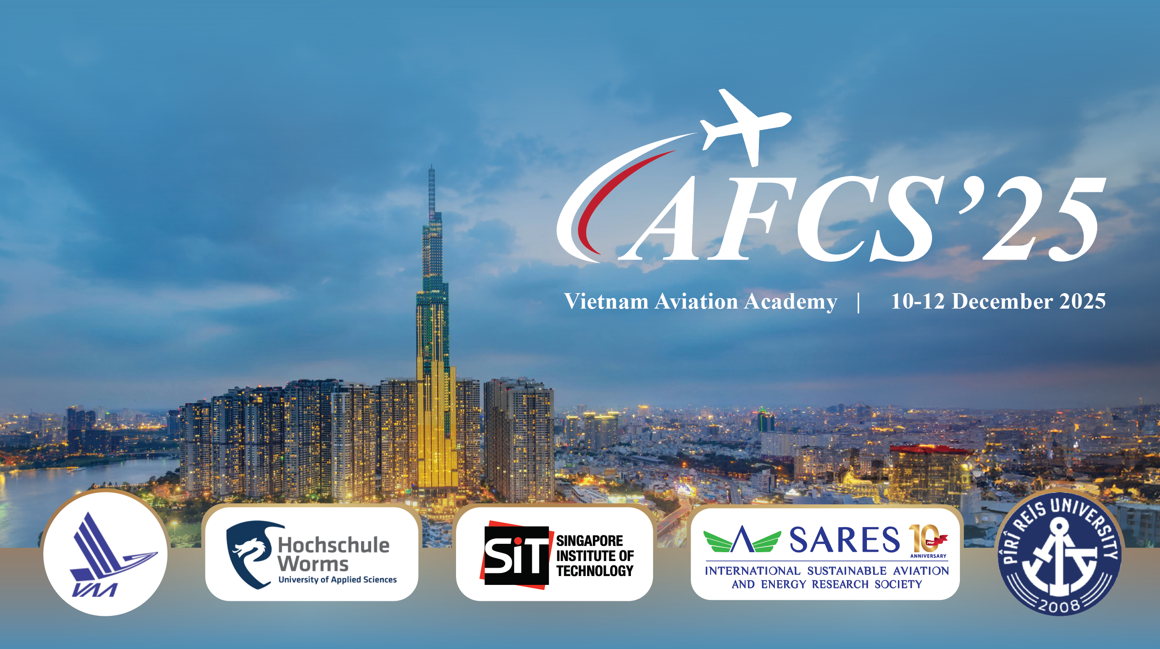
INTERNATIONAL CONFERENCE ON AVIATION FUTURE: CHALLENGES & SOLUTIONS
New Developments in Sustainable Aviation
& SARES Activities
T. Hikmet Karakoç
Dean of Research
Piri Reis University, Türkiye
President of Internatinal Sustaiable Aviation and Energy Research Society (SARES)

Slide 2
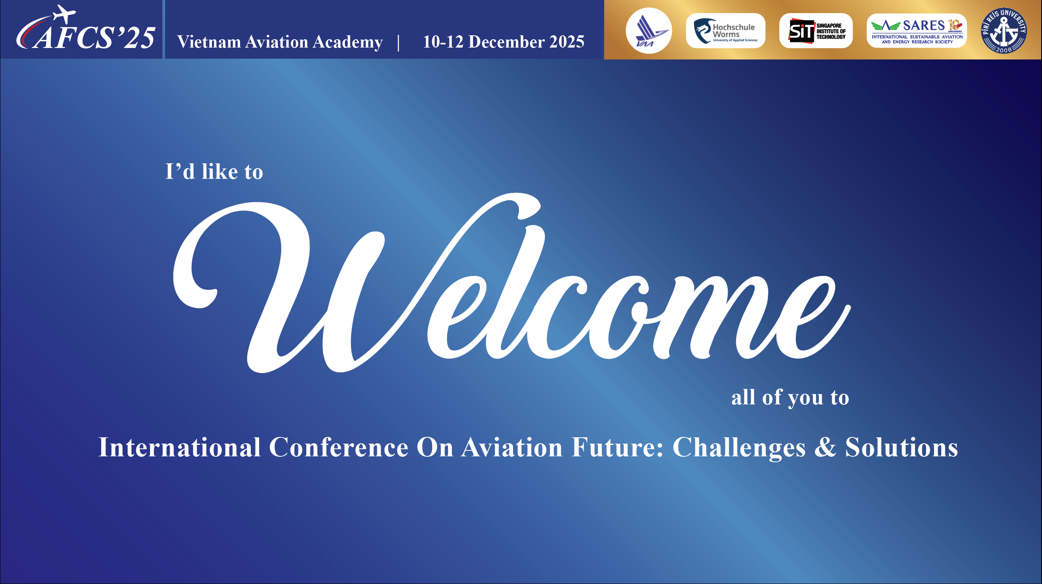
I would like to welcome each and every member to:
INTERNATIONAL CONFERENCE ON AVIATION FUTURE: CHALLENGES & SOLUTIONS

Slide 3

Introduction
The aviation industry has been increasingly focused on sustainability in recent years.
This presentation will cover some of the
New developments in sustainable aviation
Electric aviation technologies
Sustainable aviation fuels (SAF)
Aviation-related emissions and their environmental impacts
Hydrogen using in aviation
SARES Activities

Slide 4
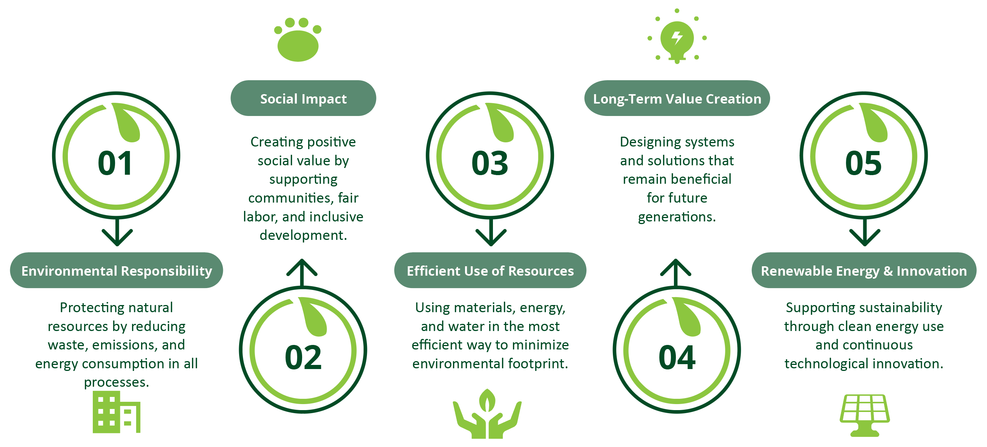
Sustainability Related to…

Slide 5
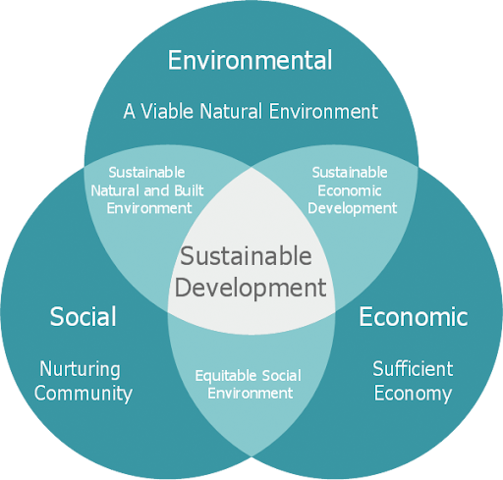
What is Sustainable Development ?
Sustainable development is a holistic approach that balances environmental protection, social equity, and economic growth. It aims to meet today’s needs while ensuring a healthy and fair future for coming generations.

Slide 6
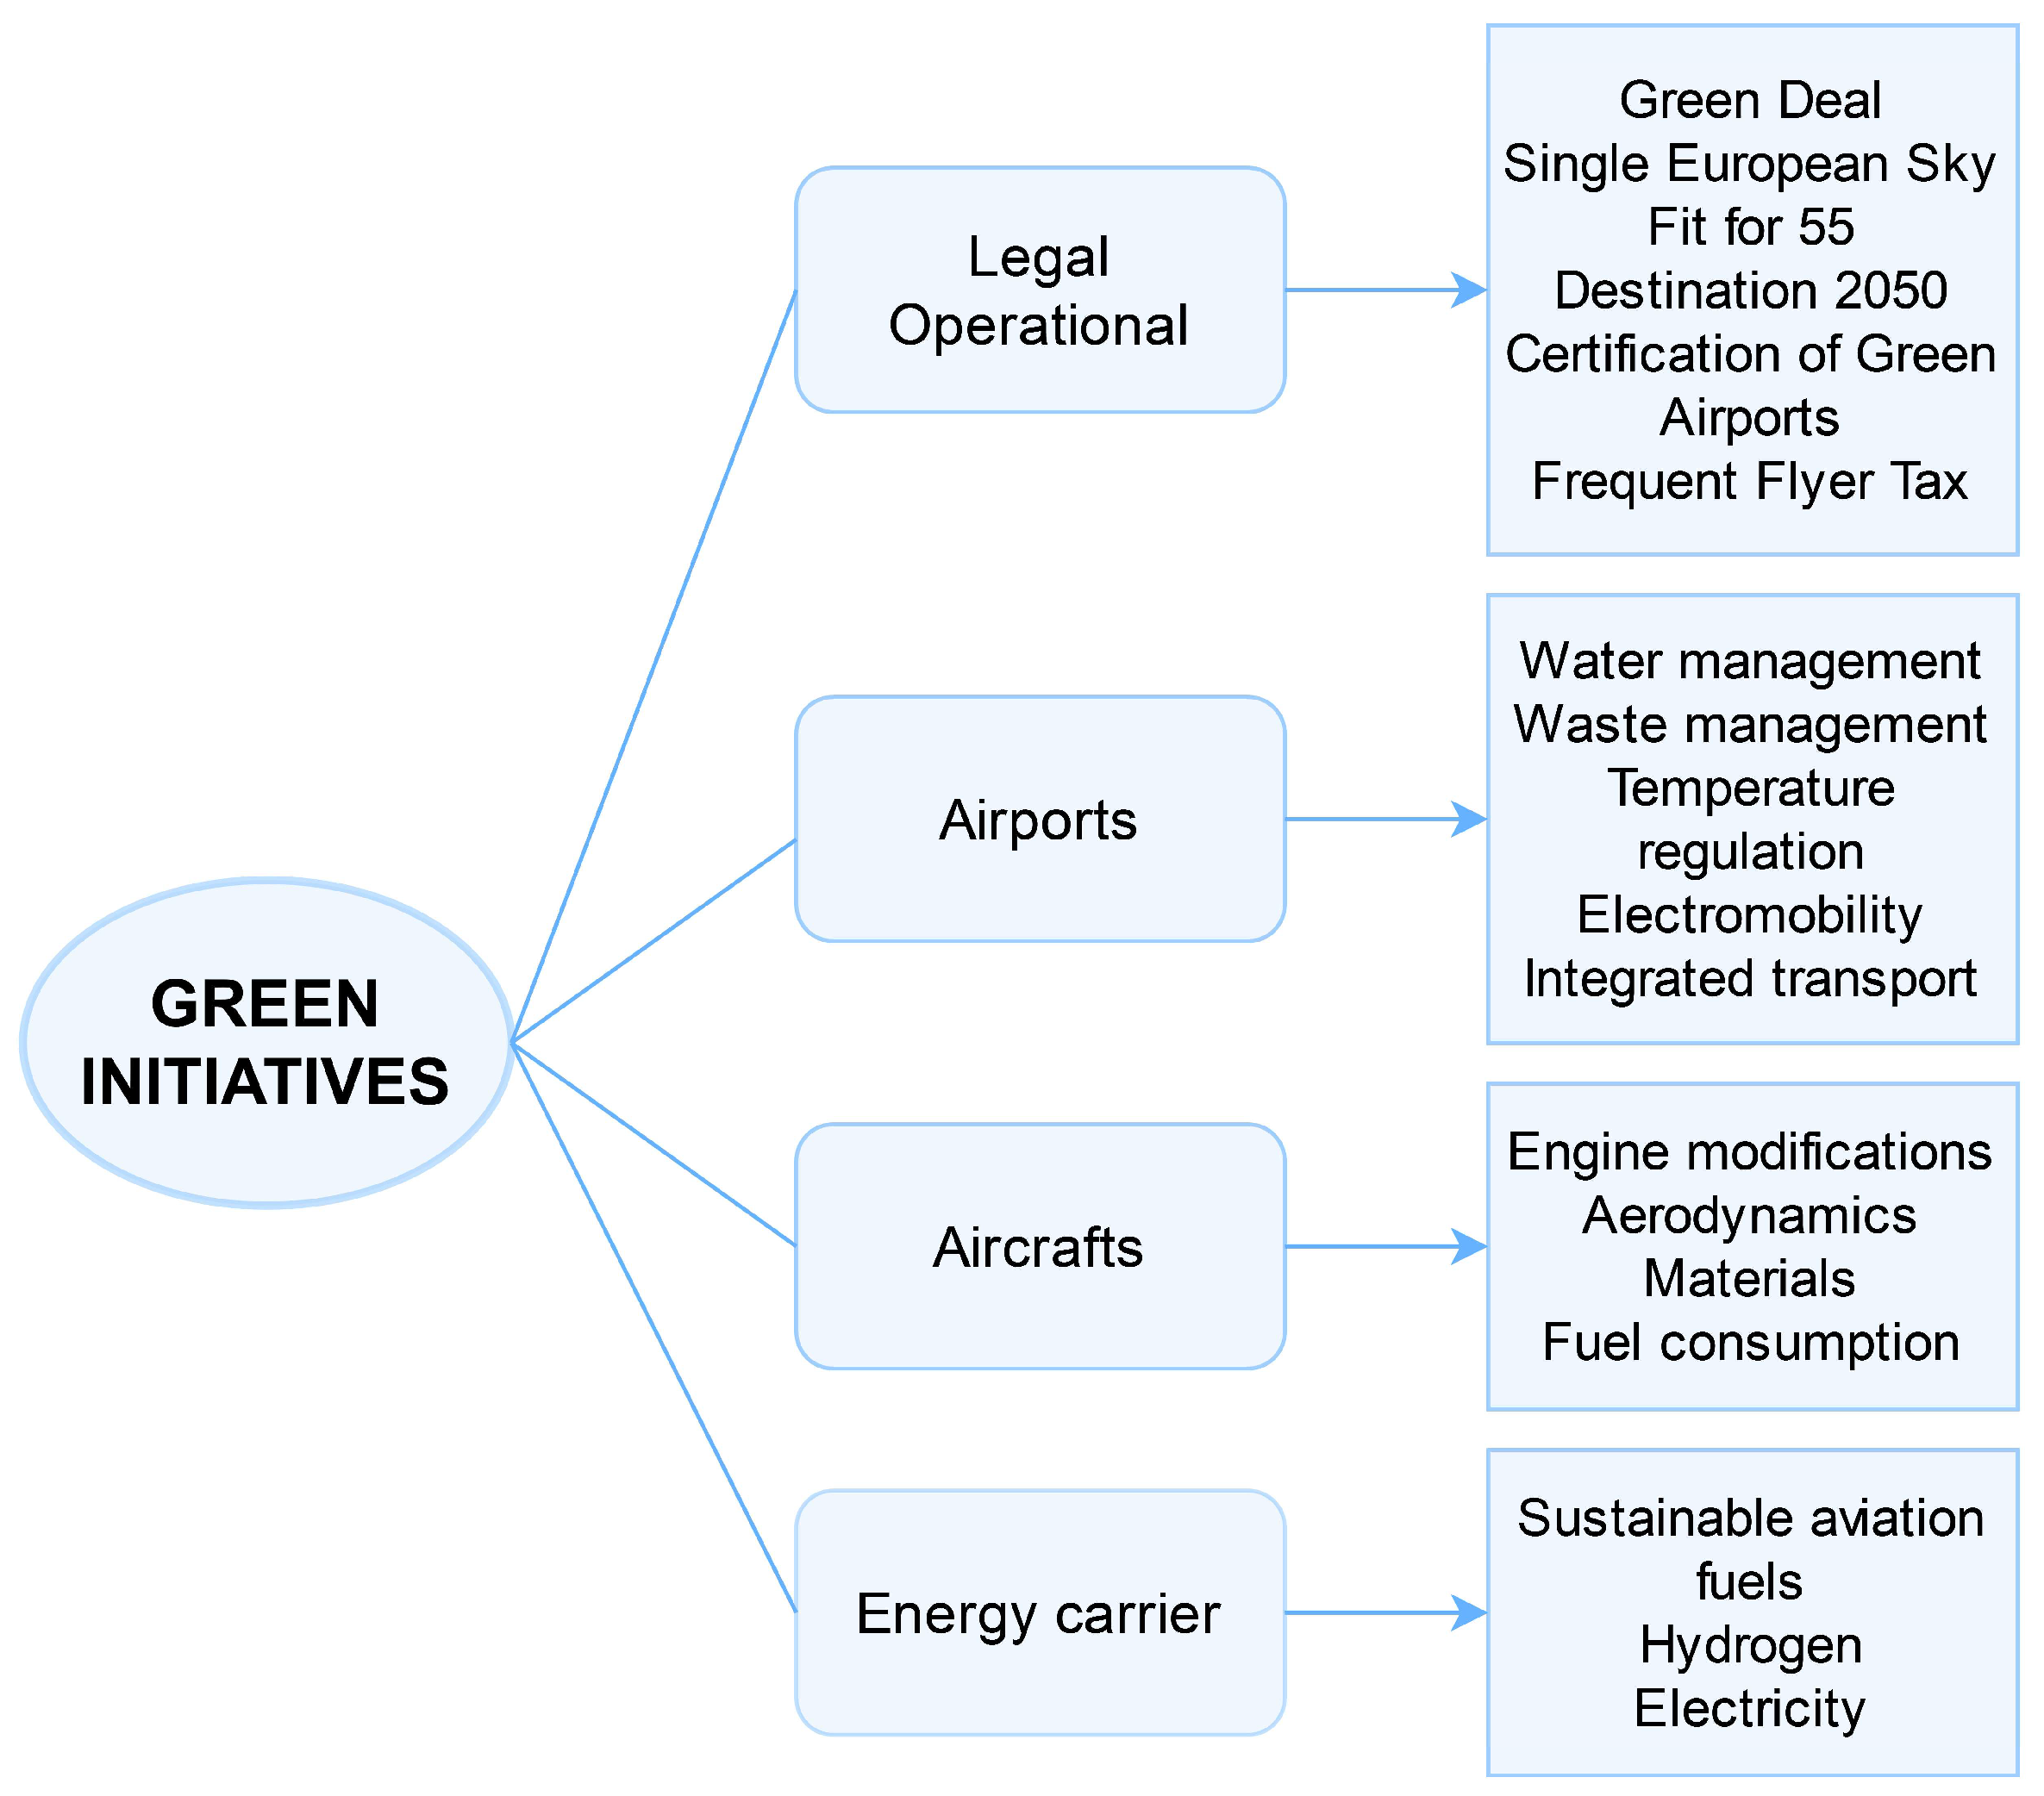
What is Sustainable Aviation?
Legal & Operational: Legal and operational measures create regulations and financial tools to guide aviation toward lower emissions and greener practices.
Korba, P., Sekelová, I., Koščáková, M., & Behúnová, A. (2023). Passengers’ Knowledge and Attitudes toward Green Initiatives in Aviation. Sustainability, 15(7), 6187.
Airports: Sustainable airports reduce environmental impact through efficient water and waste management, clean mobility, and integrated transport systems.
Aircrafts: Aircraft sustainability focuses on improving engine technology, aerodynamics, and materials to reduce fuel consumption and emissions.
Energy Carrier: Clean energy carriers such as sustainable aviation fuels, hydrogen, and electricity are key alternatives to fossil-based aviation energy.

Slide 7
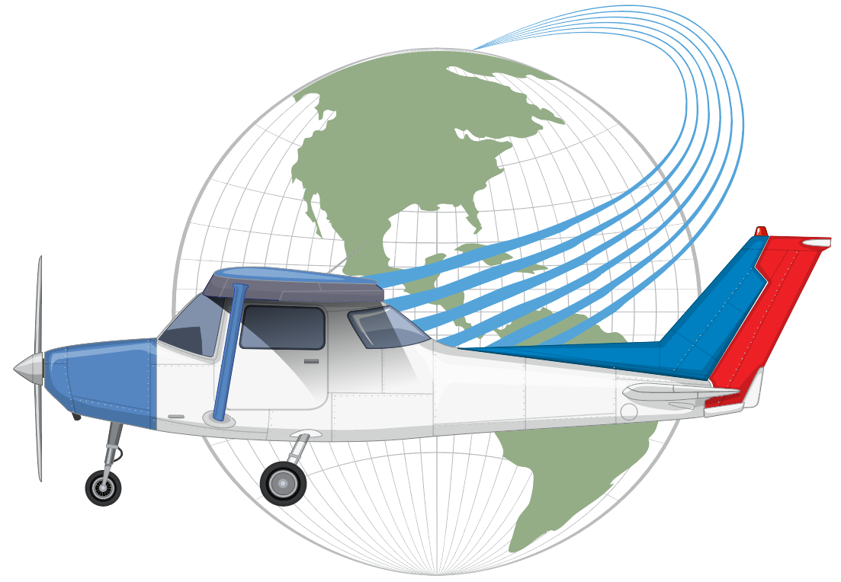

Electric Aviation
Electric aviation involves the use of electric motors instead of traditional jet engines to power aircraft.
Electric aviation is still in its early stages, but there have been some promising developments, such as the successful test flight of the world's first electric commercial aircraft in 2019.
Electric aviation has the potential to reduce emissions and noise pollution, and could be particularly useful for short-haul flights.

Slide 8
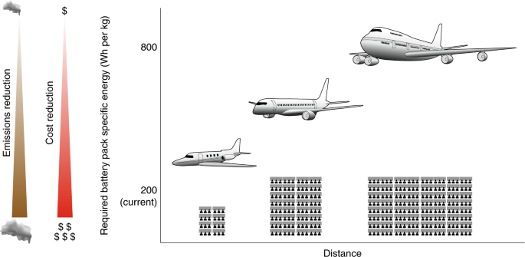
Electric Aviation
Despite its great potential, electric aviation still faces several technical and infrastructural challenges.
Need for charging and recycling infrastructure
Limited flight range
Ongoing investments and R&D
https://www.nature.com/articles/s41893-019-0233-2

Slide 9
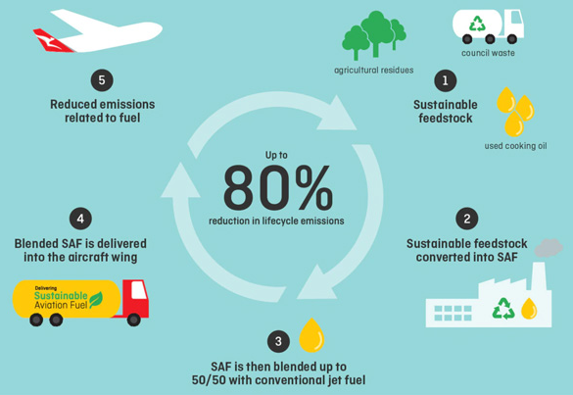
Sustainable Aviation Fuels
Sustainable aviation fuels (SAFs) are one of the most promising solutions for reducing the environmental impact of aviation.
SAFs are renewable alternative fuels made from waste and biomass.
They can reduce aviation emissions and work in existing aircraft.
Production is currently limited, and more investment is needed.

Slide 10
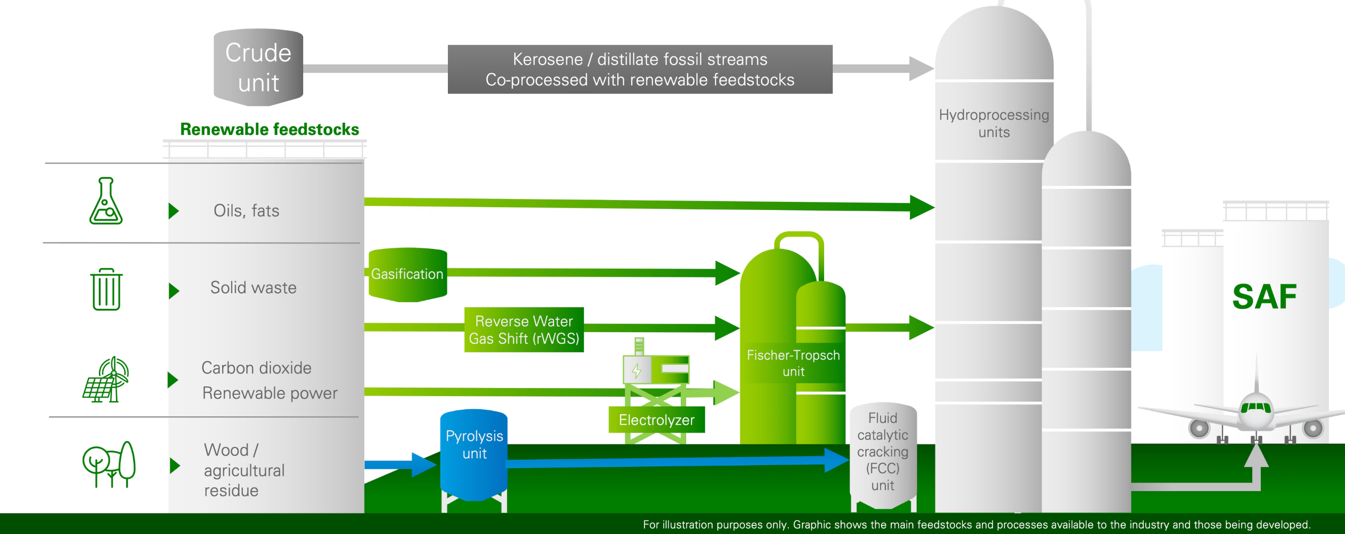
Sustainable Aviation Fuels
SAFs include bio, synthetic, and hydrogen-based fuels, and their wider use depends on increased production, lower costs, and governmental support.

Slide 11
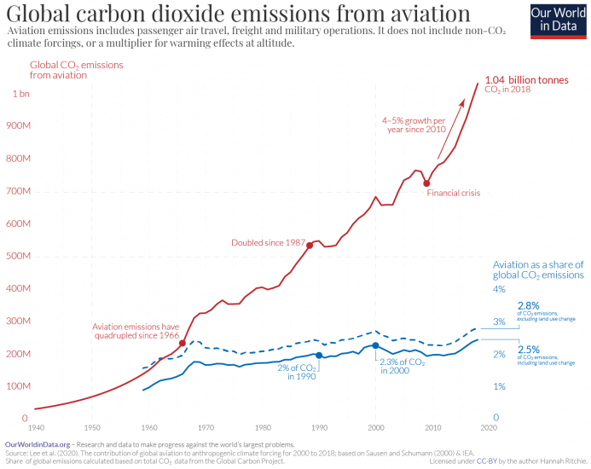
Aviation-related Emissions
Aviation emissions include CO₂, NOx, and particulate matter (PM).
2% of total global CO₂ emissions come from the aviation sector.
Emission reduction goals require advanced technologies and operational changes.

Slide 12
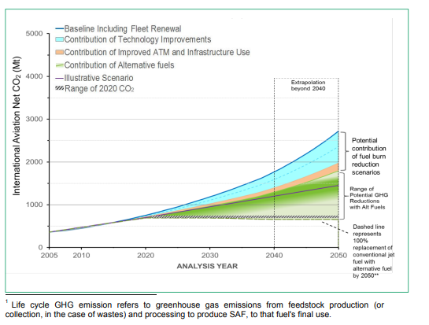
Aviation-related Emissions
Aviation emissions come not only from aircraft but also from ground and operational activities.
Ground operations and air traffic control also contribute to emissions.
Emissions are reduced through efficient aircraft, alternative fuels, and operational improvements.
Governments and global organizations support cleaner technologies through regulations and targets.
https://www.icao.int/environmental-protection/knowledge-sharing/Docs/Sustainable%20Aviation%20Fuels%20Guide_vf.pdf

Slide 13

What is Hydrogen Aviation?
Hydrogen aviation refers to the use of hydrogen as an energy source for aircraft propulsion, either through direct combustion or through fuel cell systems that generate electricity. It is considered a key long-term solution for achieving near-zero-emission air transport.

Slide 14
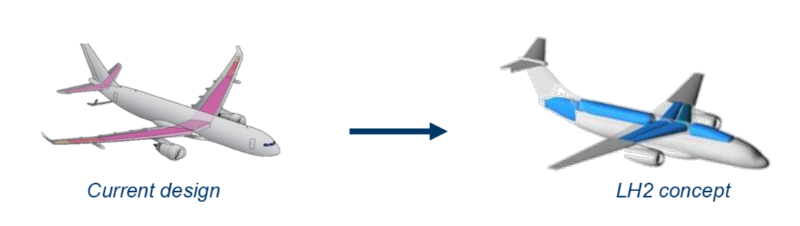
Why Hydrogen? Benefits & Current Progress
Hydrogen has a very high energy density by weight and produces no CO₂ emissions during flight when used in fuel cells. Several companies have already conducted successful hydrogen-electric test flights, proving its potential especially for short and regional routes. When produced using renewable energy, hydrogen becomes a fully climate-neutral fuel option.

Slide 15

Challenges & Future Outlook
Hydrogen requires large, cryogenic storage systems, which significantly affect aircraft design, weight, and aerodynamics. In addition, airport infrastructure for hydrogen production, storage, and refueling is still limited. Despite these challenges, major manufacturers, governments, and international organizations aim to introduce the first commercial hydrogen-powered aircraft by the 2030s.

Slide 16
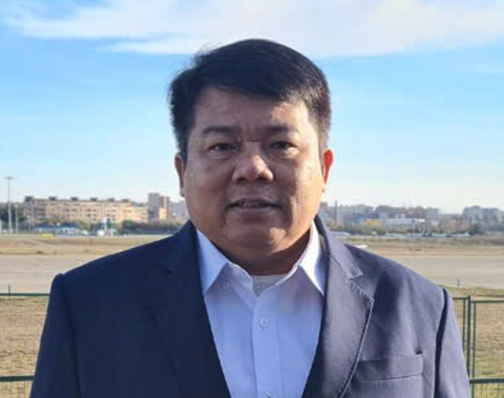

Special Thanks to Commitee Members
Tran Hoai An
Chairman of Vietnam Aviation Academy
Nguyen Thi Hai Hang,
President of Vietnam Aviation Academy

Slide 17

Special Thanks to Commitee Members
Hans Rück
Vice-President of Worms University of Applied Sciences

Slide 18
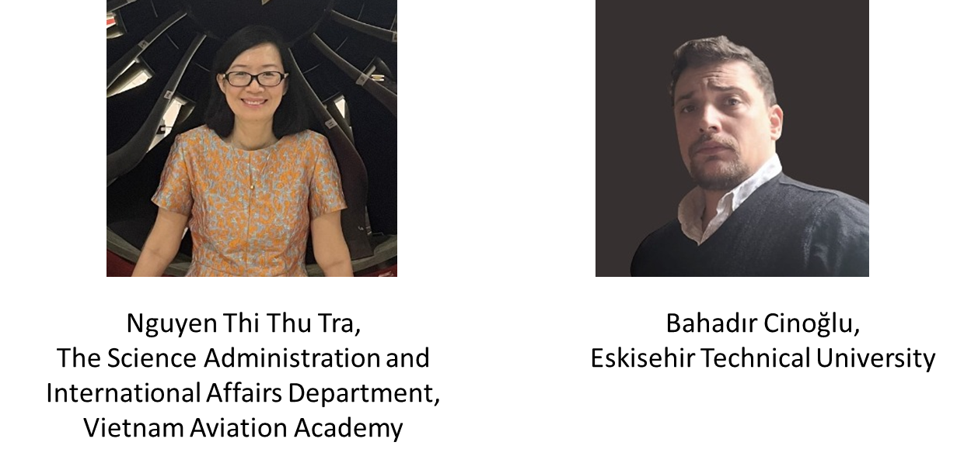

Special Thanks to Technical Chairs
An Vo
Worms University of Applied Sciences

Slide 19


Slide 20
Main Objectives of SARES
➤ Research into green and environmentally friendly energy resources and aviation technologies
➤ Research into sustainable infrastructure development under a changing climate
➤Teaching, research and professional development in the area of renewable energy technologies and sustainable aviation
➤ Supporting institutions affiliated with renewable energy and sustainable aviation development
➤ Providing information and documentation about renewable energy and sustainable aviation research & development
➤ Publishing a journal (IJAST), books, proceedings, and bulletins related to renewable energy and sustainable aviation research & development

Slide 21

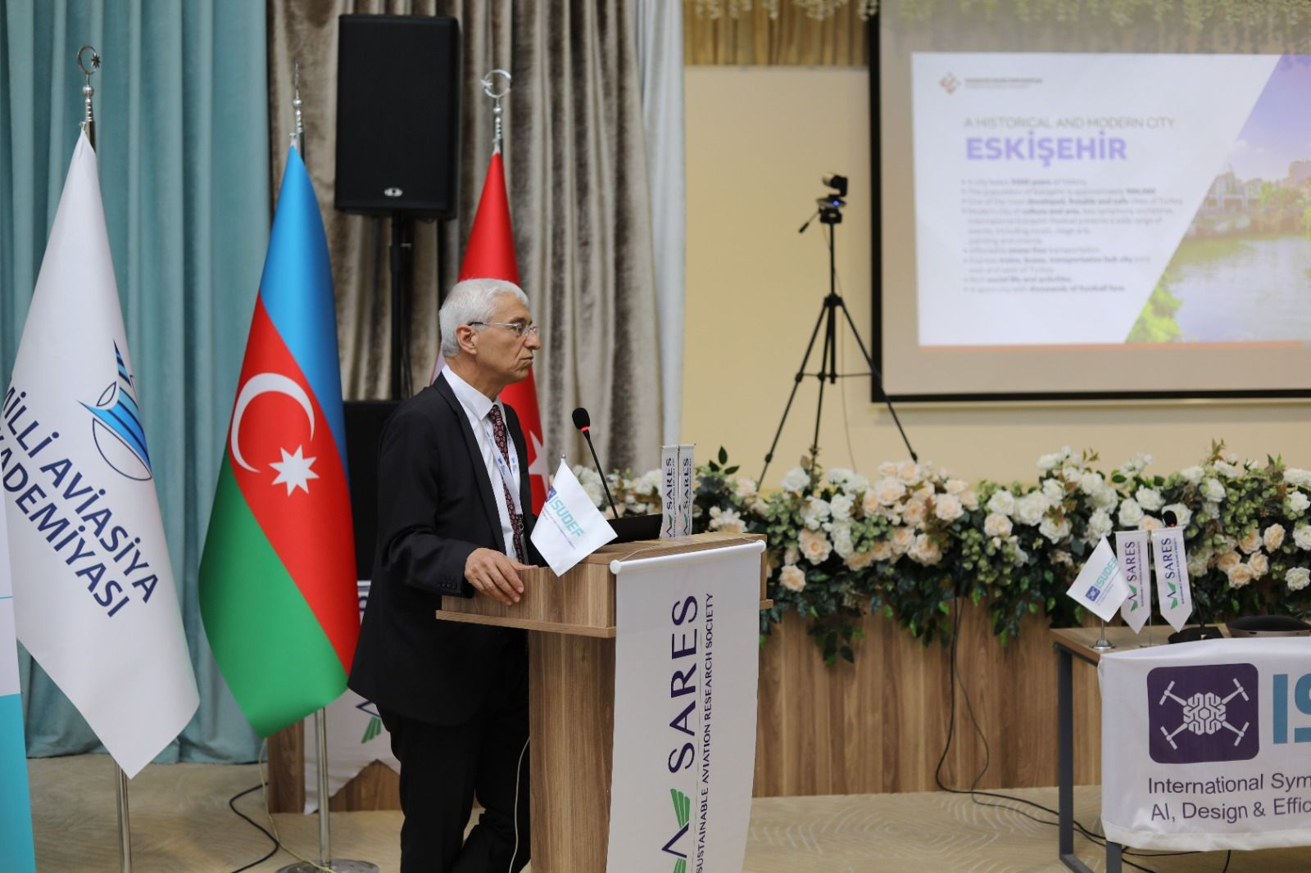
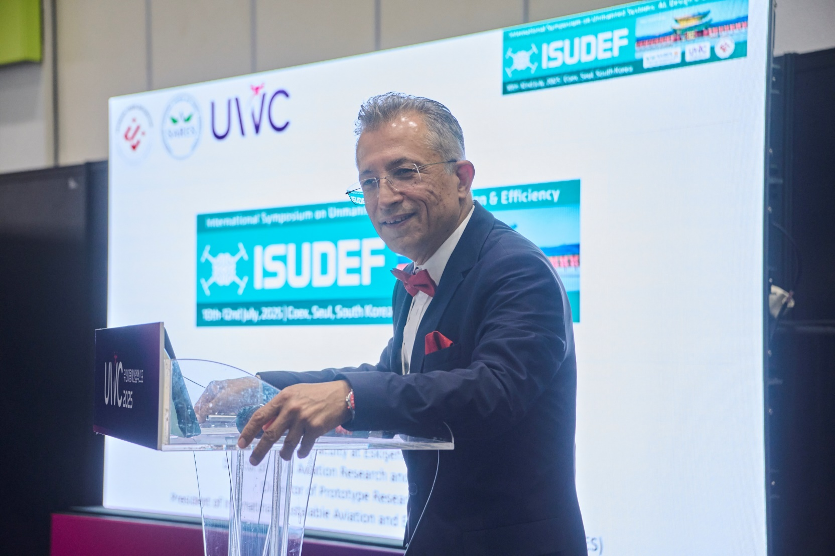
International Symposiums and Activities
2020 Kiev/Ukraine
2021 Washington DC/USA
2022 Madrid/Spain
2023 Stockholm/Sweden
2024 Baku/Azerbaijan
2025 South Korea

Slide 22
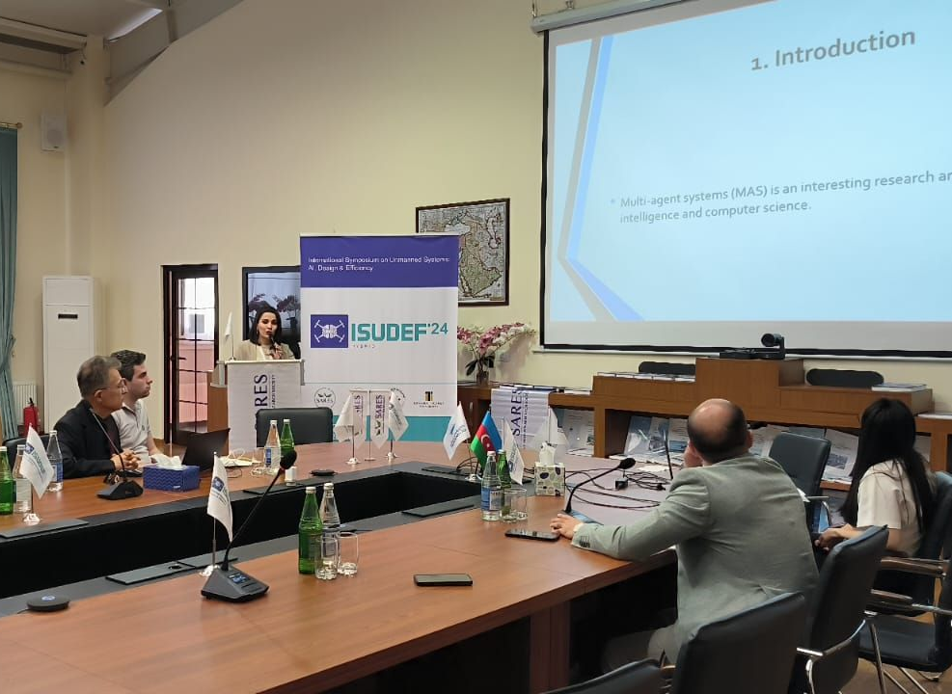
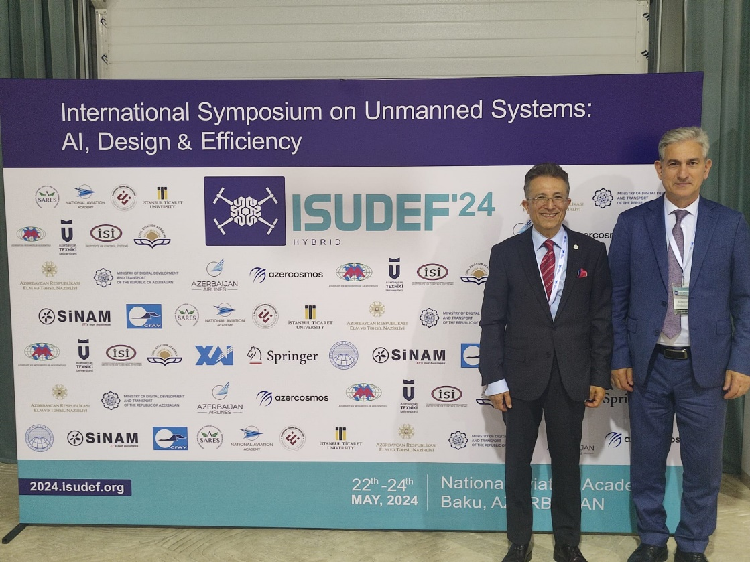
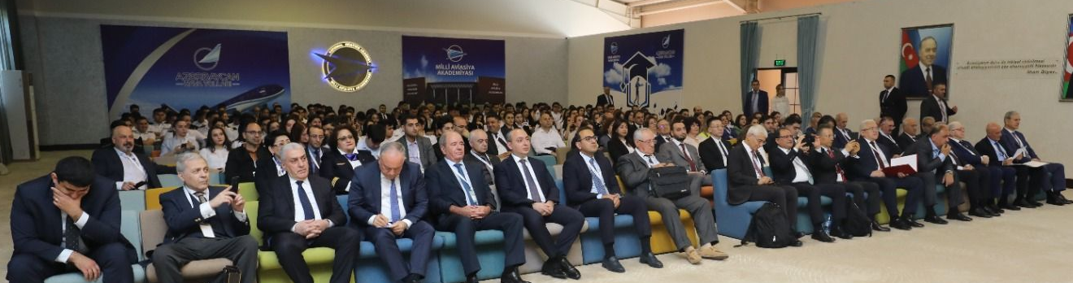
International Symposiums and Activities (ISUDEF’24- Baku-Azerbeijan)

Slide 23
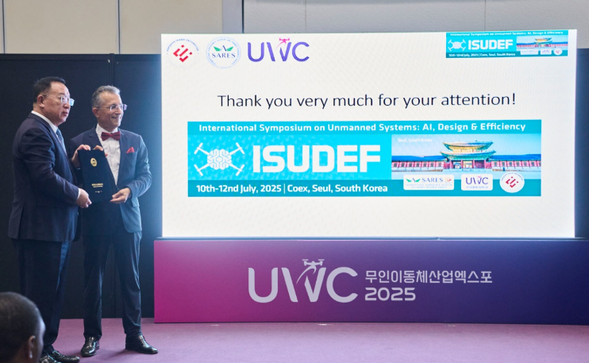
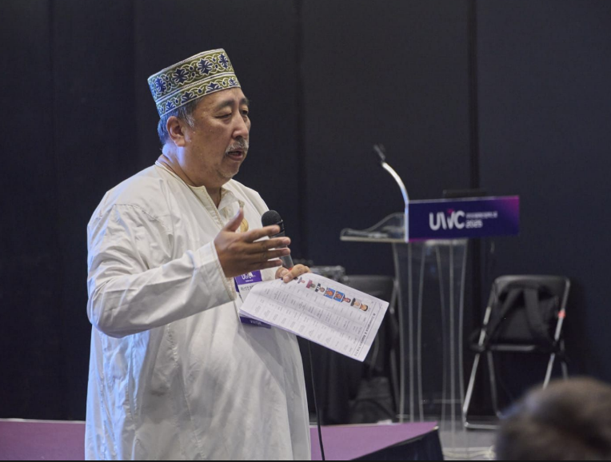
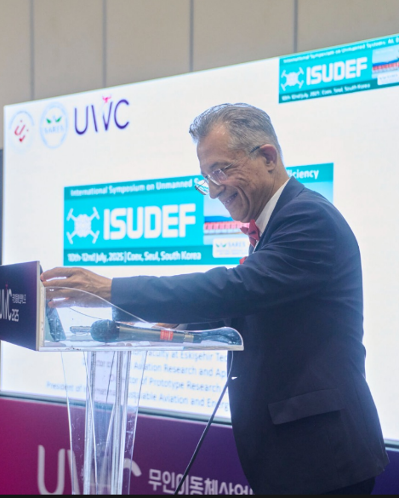
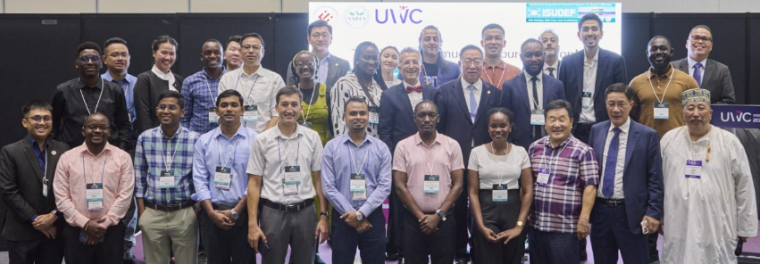
International Symposiums and Activities (ISUDEF’25-Soul-South Korea)

Slide 24
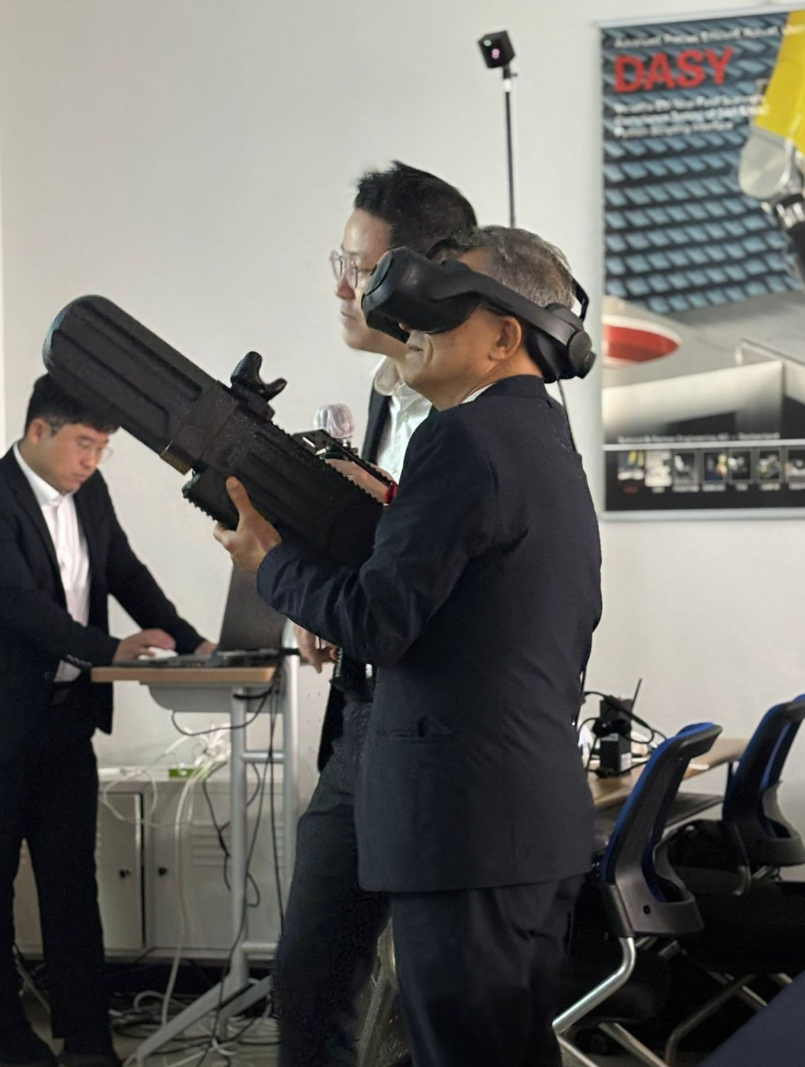
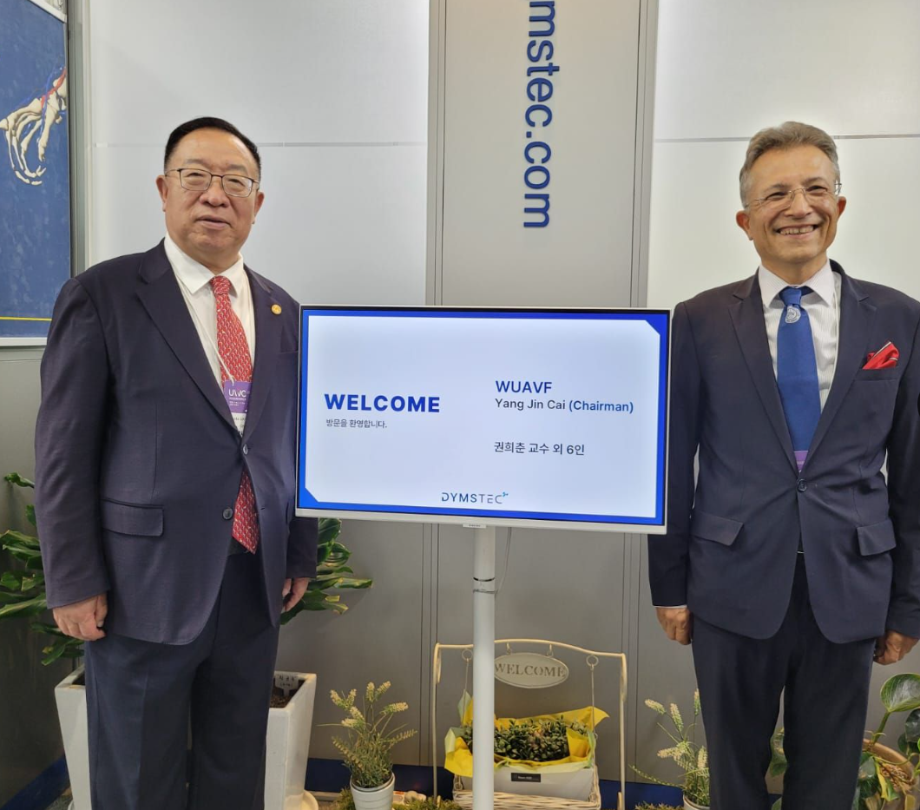
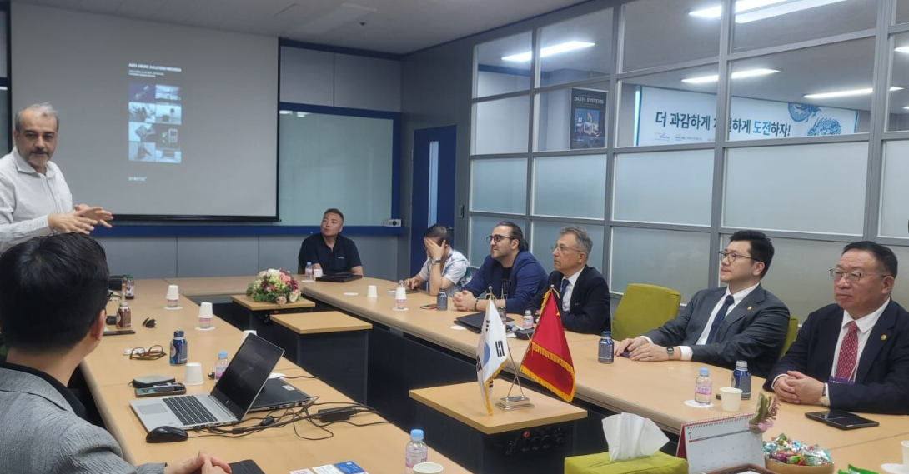
International Symposiums and Activities (ISUDEF’25-Soul-South Korea)

Slide 25
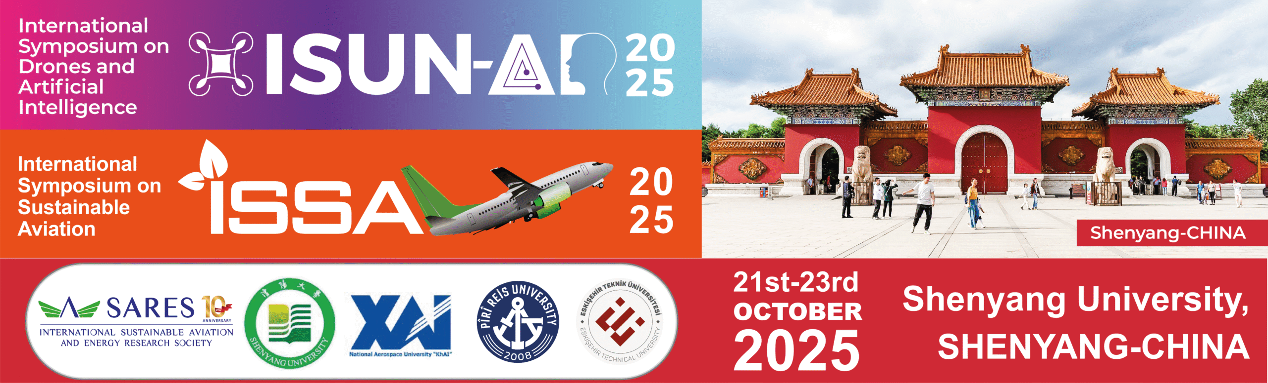
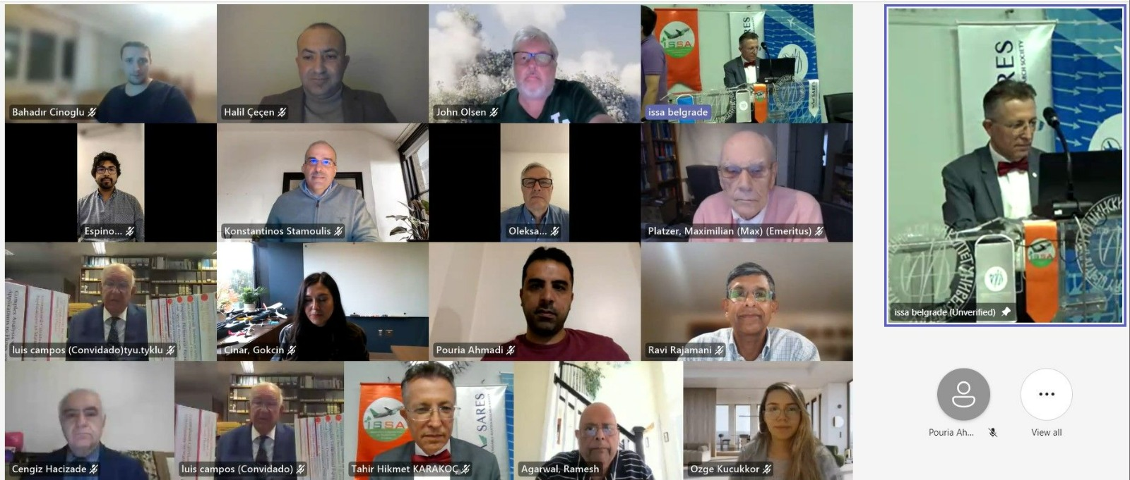
International Symposiums and Activities
2015 İstanbul/Türkiye
2016 İstanbul/Türkiye
2017 Kiev/Ukraine
2018 Rome/Italy
2019 Budapest/Hungary
2020 Kuala Lumpur/Malaysia
2021 Bangkok/Tailand
2022 Melbourne/Australia
2023 Tainan/Taiwan
2024 Belgrade/Serbia
2025 Shenyang/China (Shenyang Aerospace University)

Slide 26


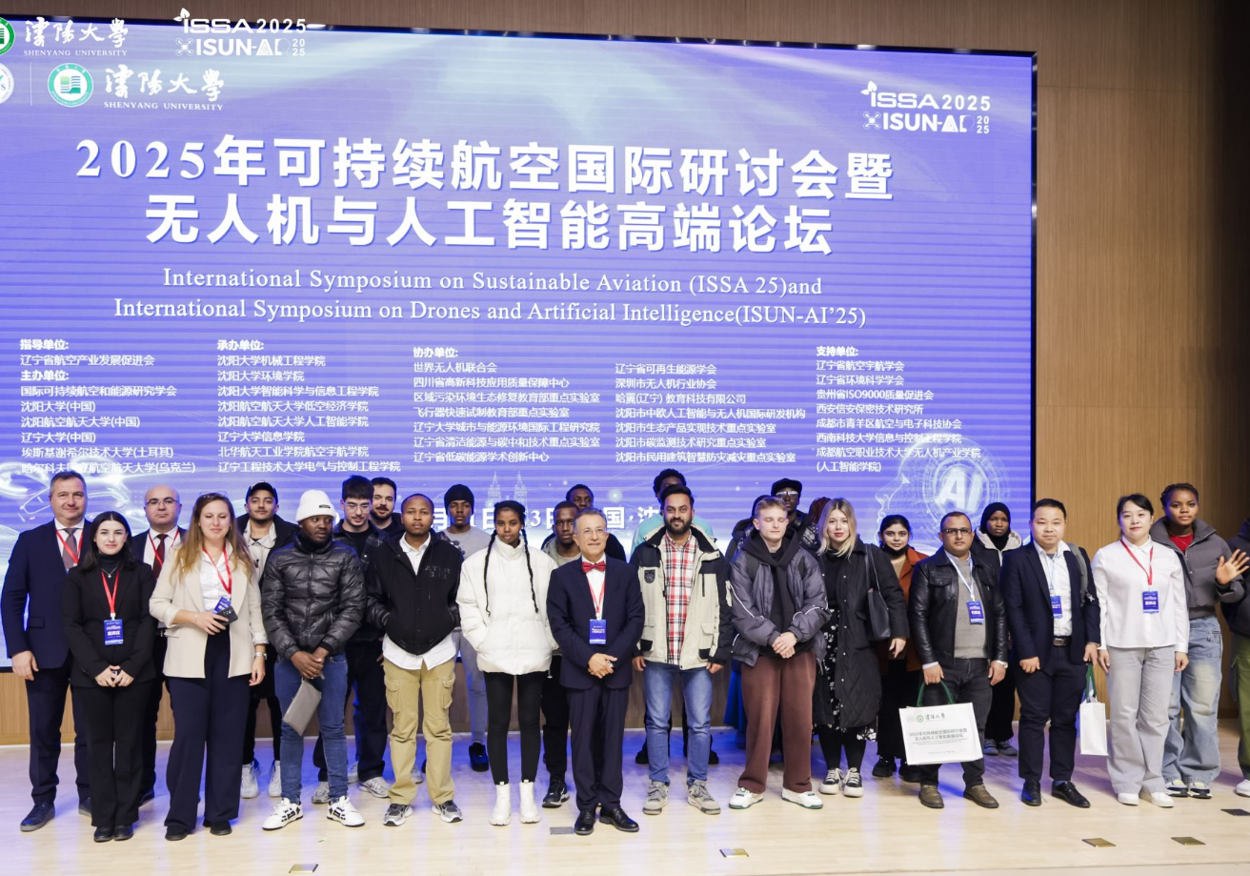
International Symposiums and Activities (ISSA’25 Shenyang Aerospace University, China)

Slide 27
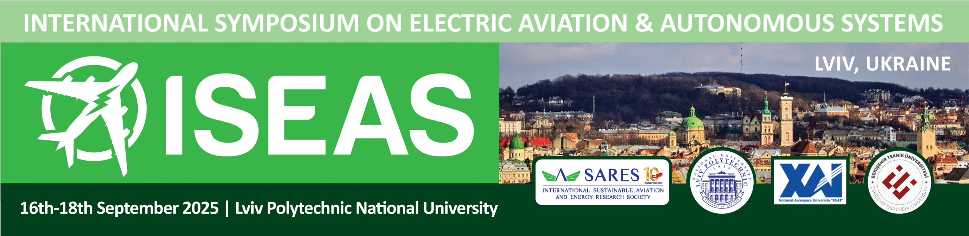
International Symposiums and Activities
2017 Kiev/Ukraine
2018 İstanbul/Türkiye
2019 Budapest/Hungary
2020 Kiev /Ukraine
2021 Eskişehir/Türkiye
2022 Maribor/Slovenia
2023 Warsaw/Poland
2024 Las Vegas/USA
2025 Lviv/Ukraine
2026 Ozbekhistan (Planning)

Slide 28
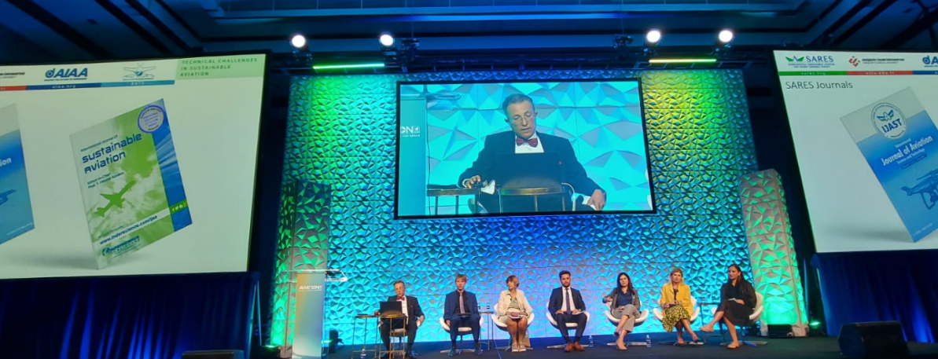
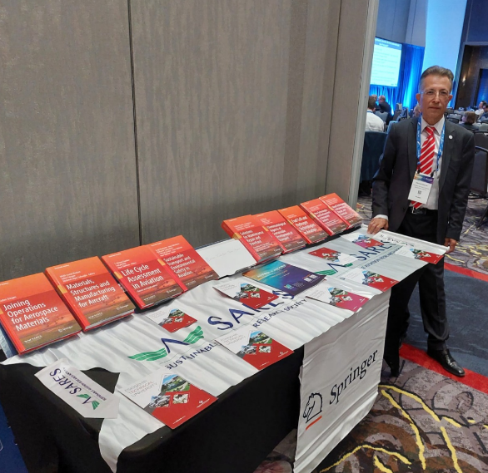

International Symposiums and Activities (ISEAS’24-Las Vegas-USA)

Slide 29
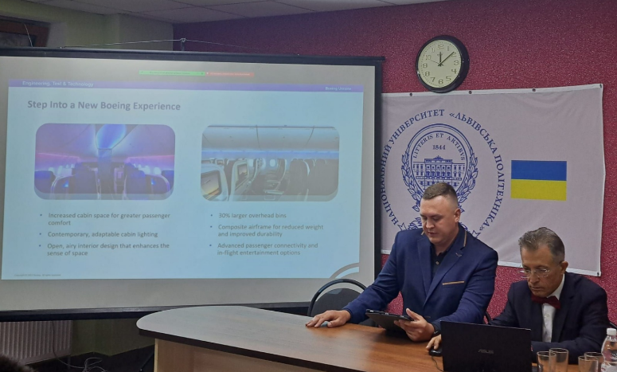
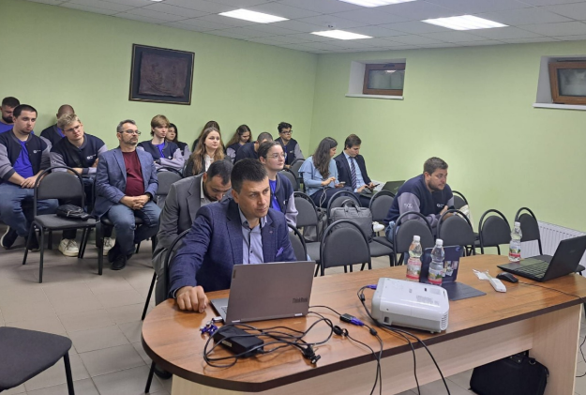

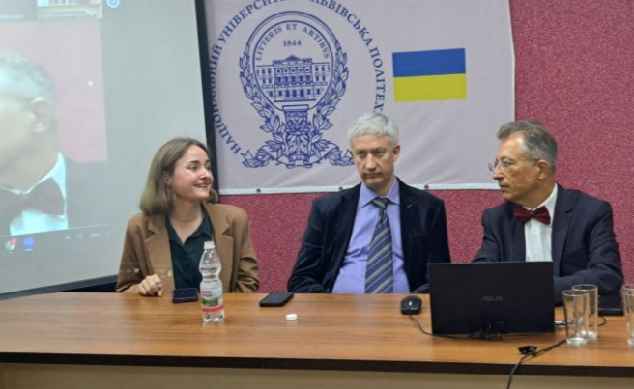
International Symposiums and Activities (ISEAS’25-Lviv-Ukraine)

Slide 30
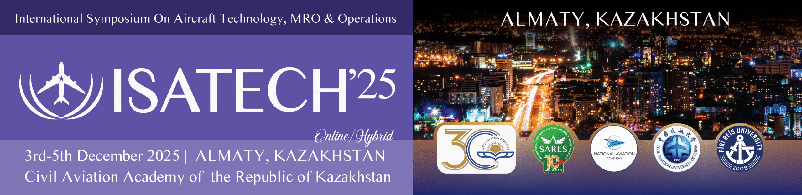
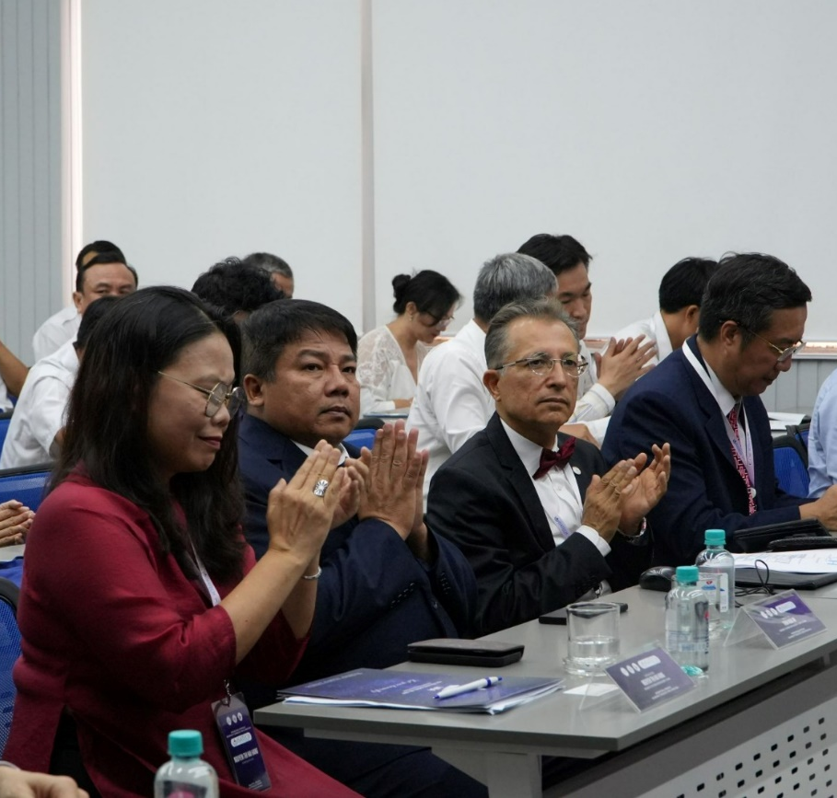
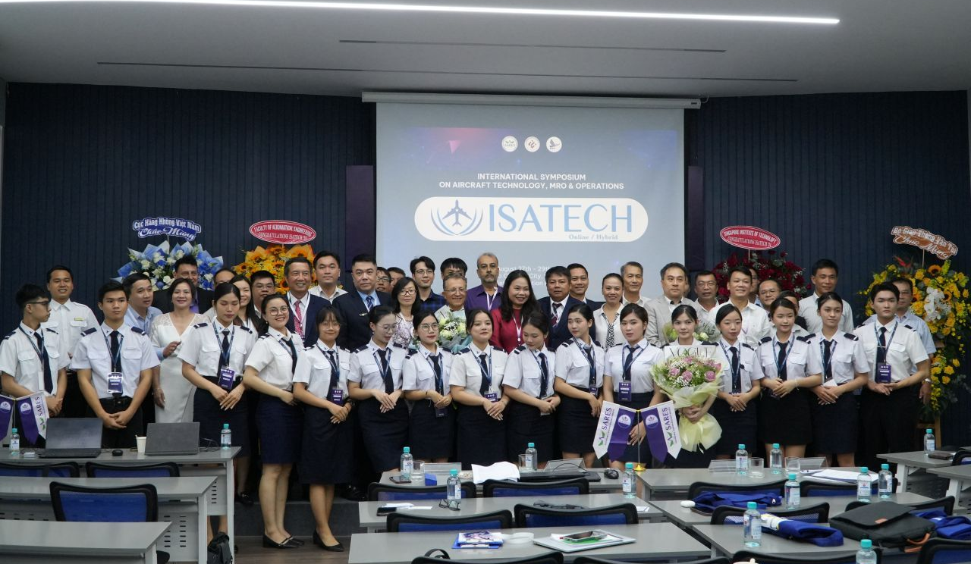
International Symposiums and Activities
2018 İstanbul/Türkiye
2019 Amsterdam/Netherlands
2020 Kiev/Ukraine
2021 Budapest/Hungary
2022 Belgrad/Serbia
2023 Hanoi, Vietnam
2024 Ho Chi Ming City, Vietnam
2025 Almati, Kazakhstan (National Aviation Academy)
2026 Amsterdam, Netherlands (Amsterdam University of Applied Sciences )

Slide 31
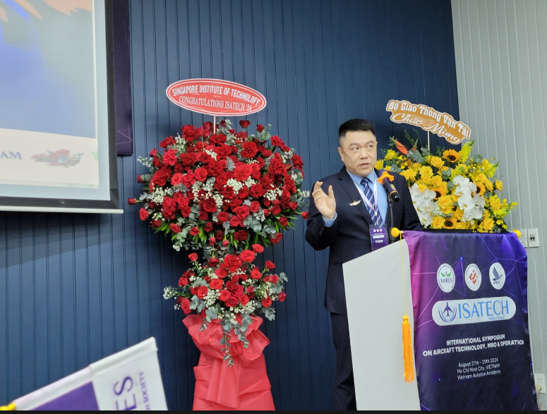
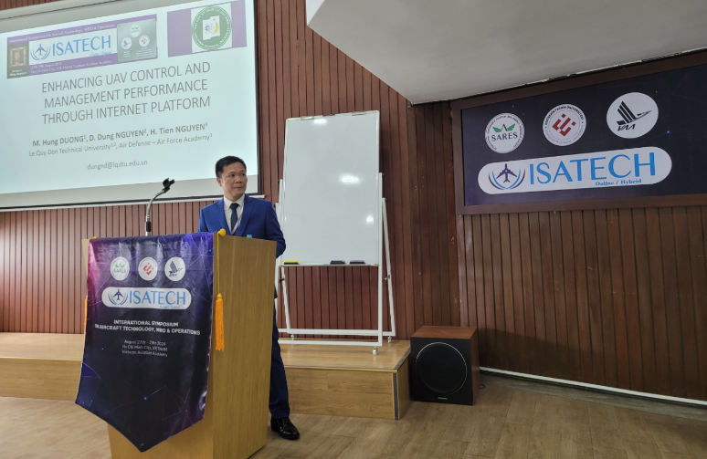
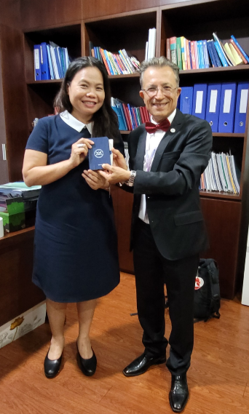

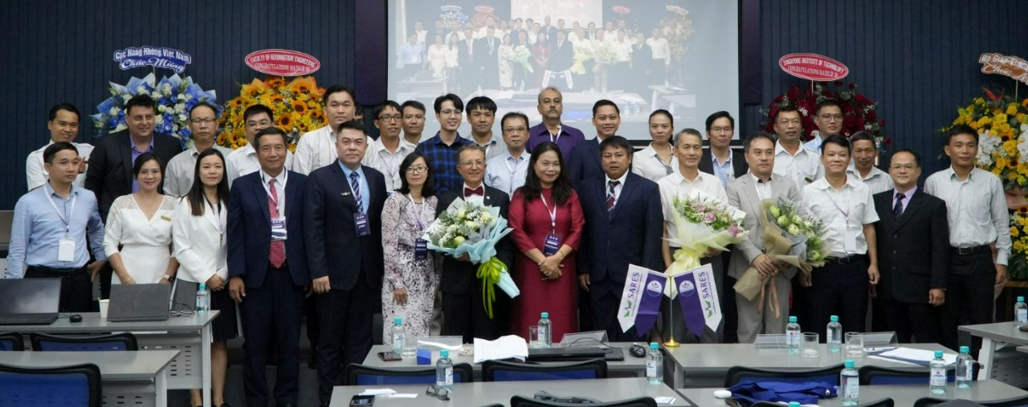
International Symposiums and Activities
(ISATECH’24-Ho Chi Minh City-Vietnam)

Slide 32
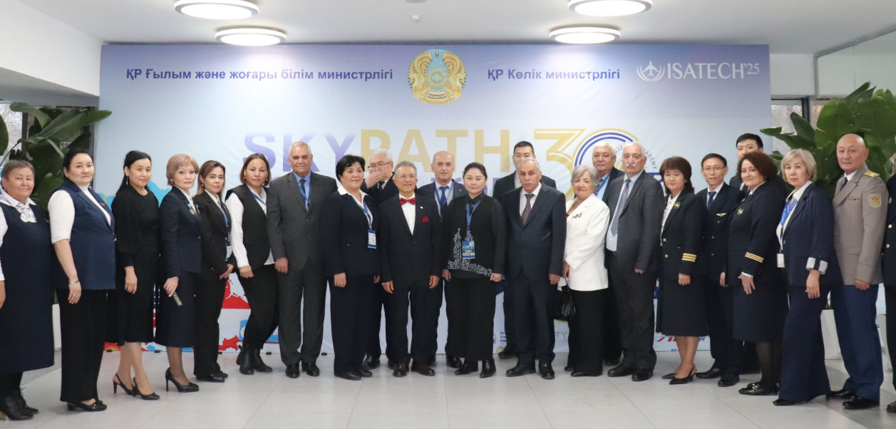
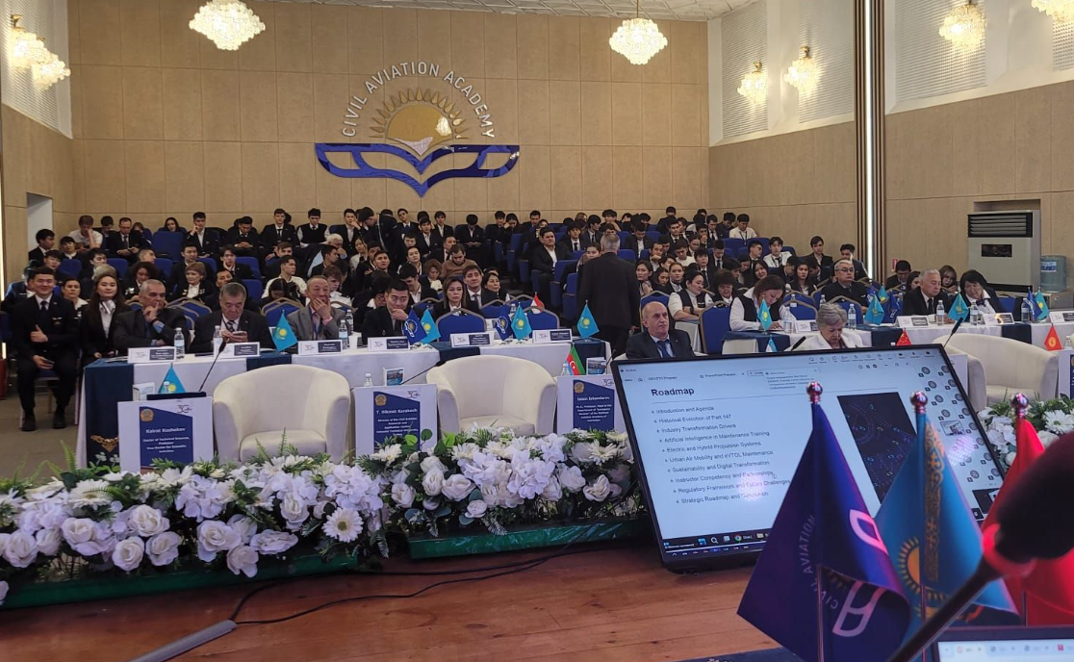
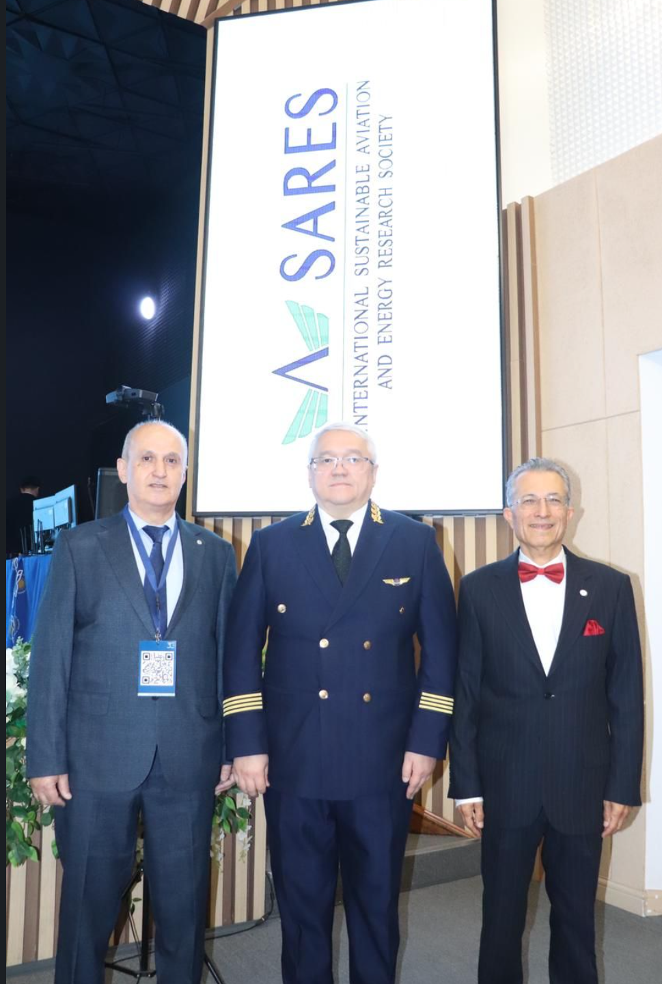
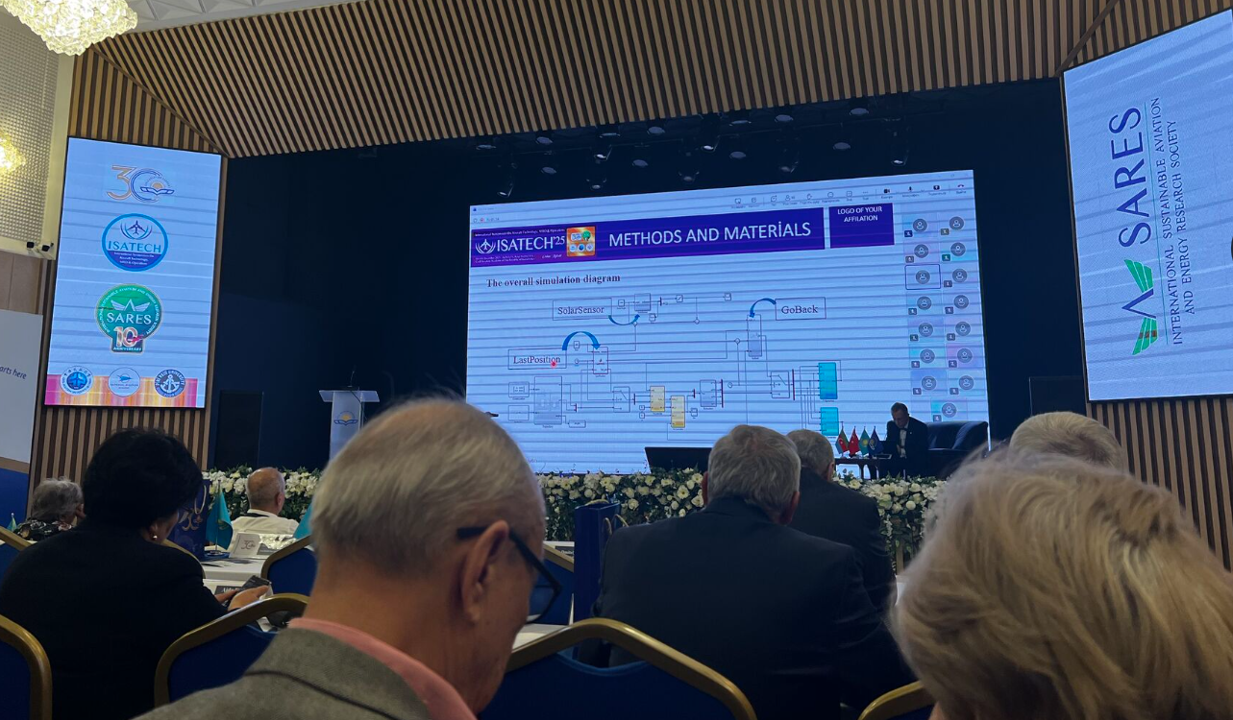

International Symposiums and Activities (ISATECH’25-Almaty-Kazakhstan

Slide 33
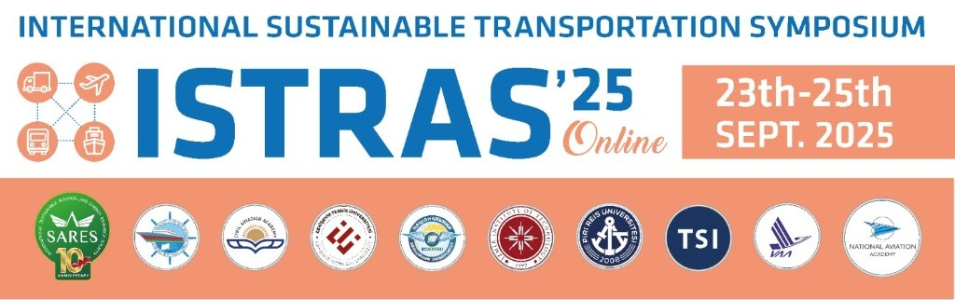
International Symposiums and Activities
2025 Coordinator: NAA-SARES

Slide 34

International Symposiums and Activities

Slide 35
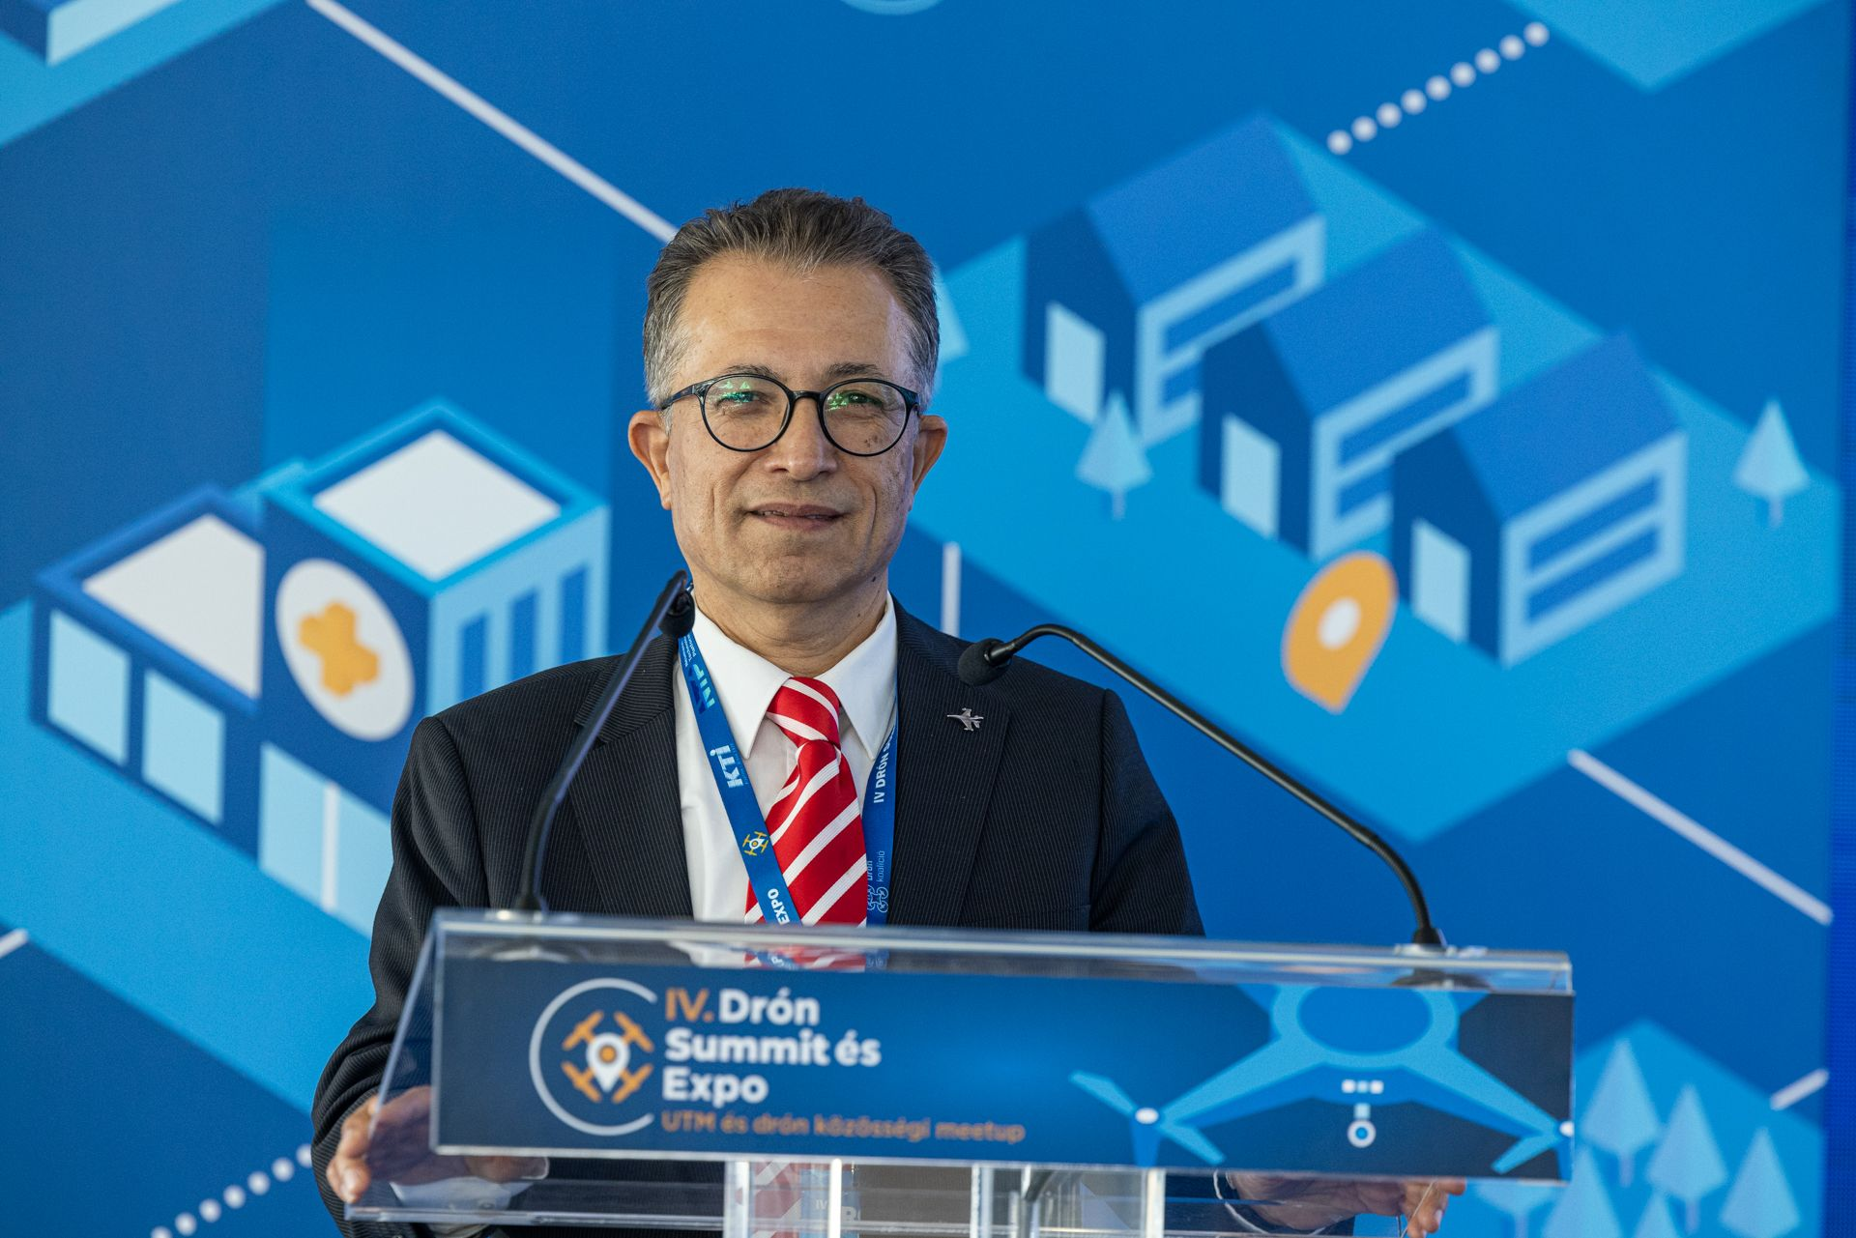
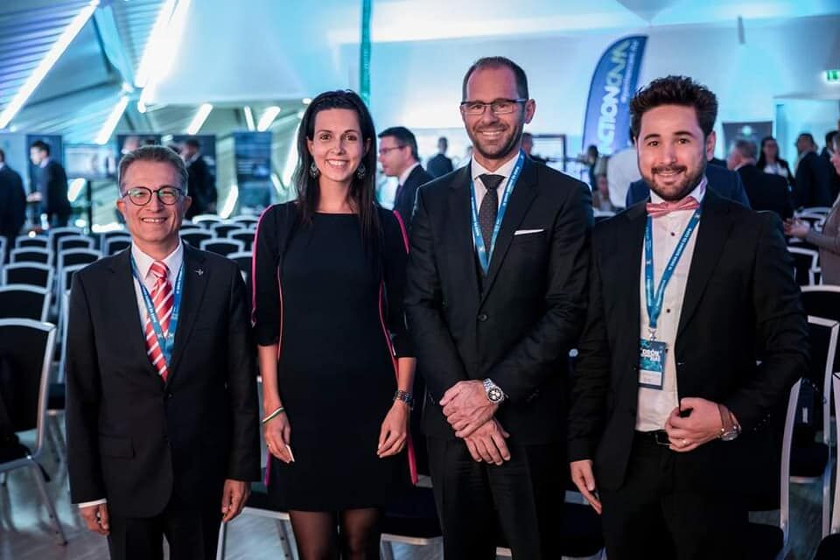
International Symposiums and Activities
Visit to Budapest, Hungary- "IV. Drone Summit and Expo Hungary".
"Unmanned Aerial Vehicle Systems, Applications and Research in Turkey and Cooperation Opportunities Between Turkey and Hungary".

Slide 36
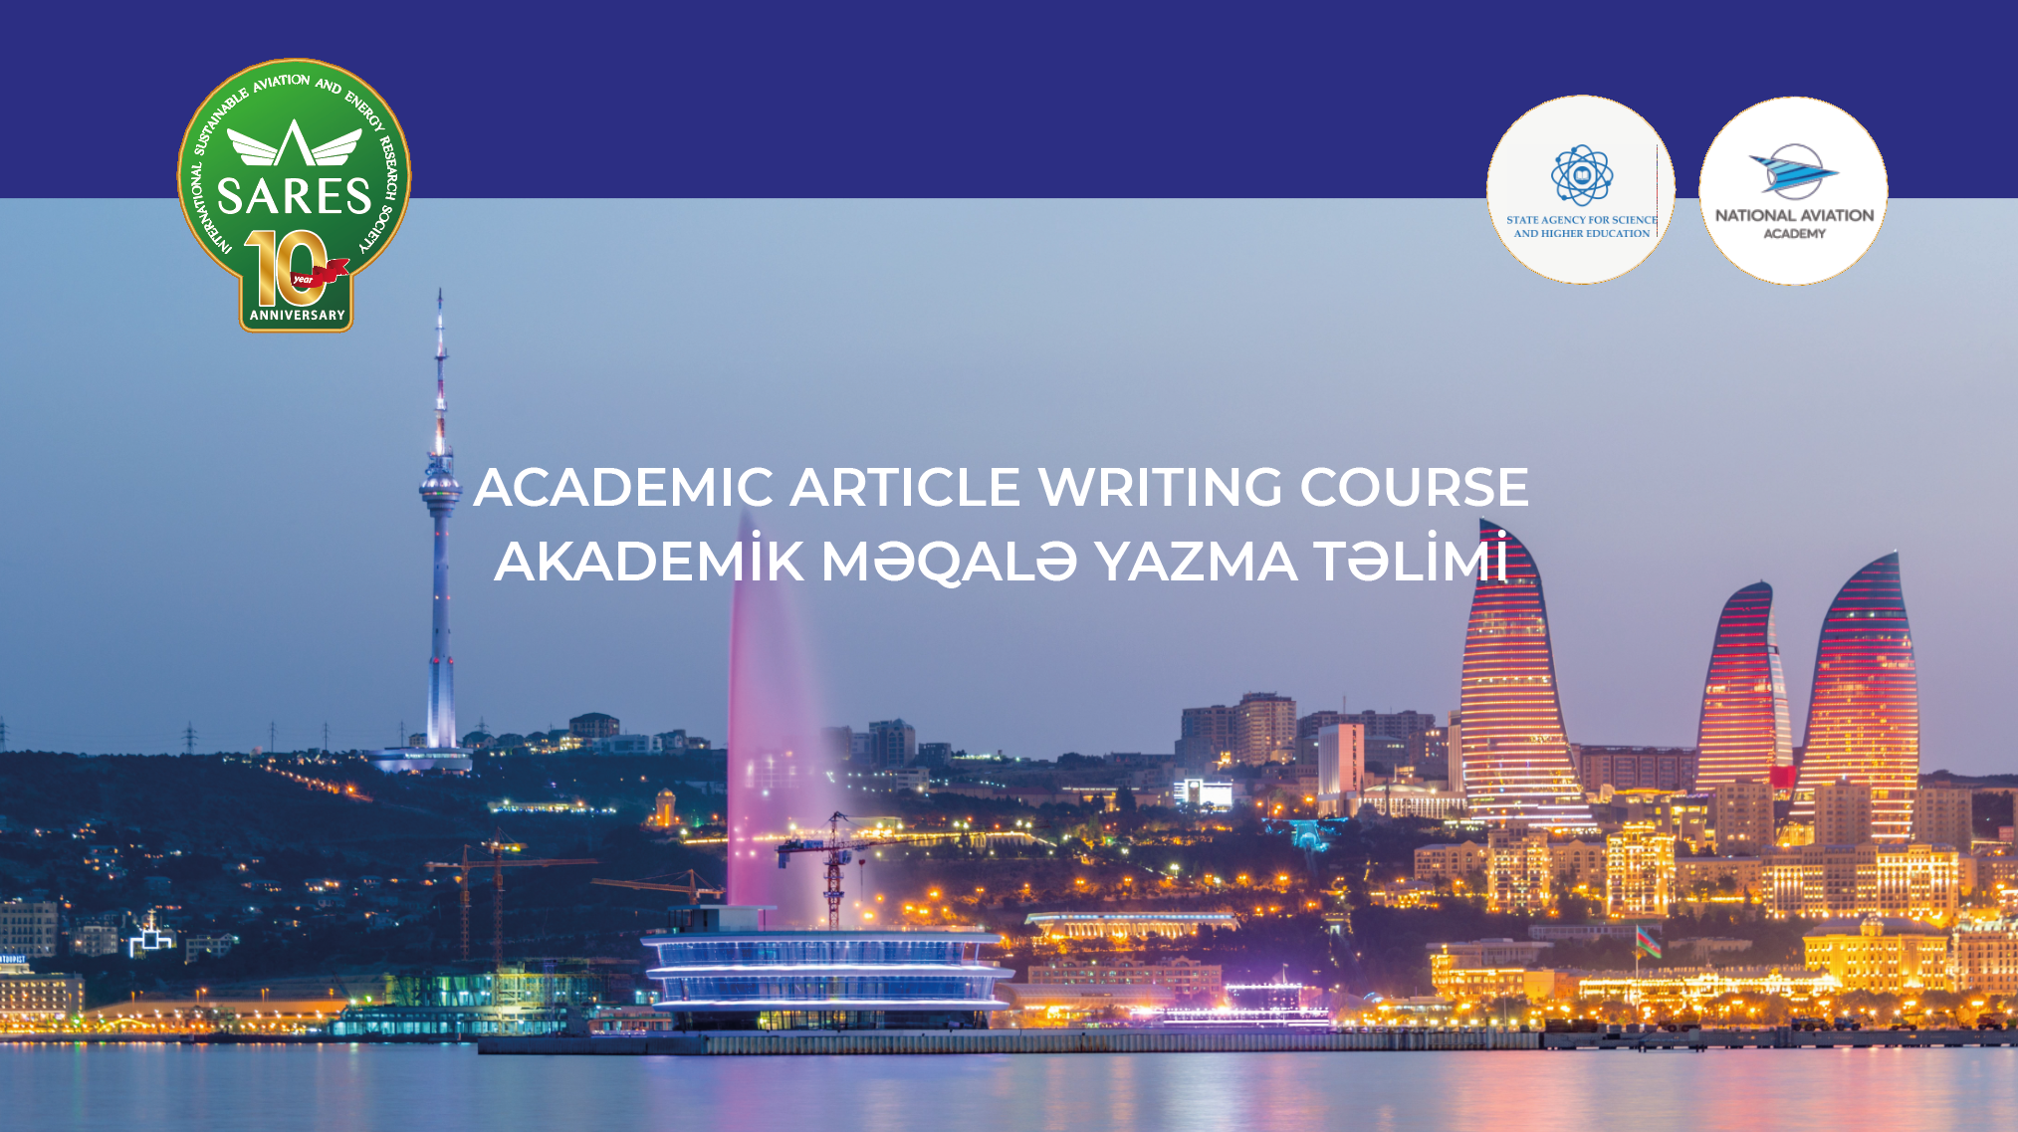

Slide 37


Slide 38



Slide 39



International Journals

Slide 40

International Symposiums and Activities
Springer: Sustainable Aviation Book Series
As SARES, we are publishing ”Sustainable Aviation Books” yearly after every symposium.
We are going to publish 25 books during 5 years beginning to 2023
5 edited books + 4 Proceeding books in 2022
5 edited books + 4 Proceeding books in 2023
5 edited books + 4 Proceeding books in 2024
5 edited books + 4 Proceeding books in 2025
5 edited books + 4 Proceeding books in 2026
SARES has already published 6 Special books in various subjects in Springer. In total 13 books including Proceedings.

Slide 41



International Symposiums and Activities
As SARES, we are publishing ”Sustainable Aviation Books” yearly after every symposium.
Up to date, SARES has already published 3 books in Springer.

Slide 42

International Symposiums and Activities

Slide 43

International Symposiums and Activities
Symposium Proceedings Publications

Slide 44

International Symposiums and Activities
One of our book; Unmanned Aerial Vehicle Design and Technology will translate to Chinese upon request from China

Slide 45

Collaboration Projects
https://e-uav.org/en/index.php

Slide 46

Collaboration Projects
https://e-uav.org/en/index.php

Slide 47

Collaboration Projects
https://e-uav.org/en/index.php
Notes:
Also there are free e learning courses about UAVs.

Slide 48


Collaboration Projects
https://e-uav.org/en/index.php

Slide 49




Slide 50


Kairat Koshekov
Kazahkistan
Updated: 14.04.2025

Slide 52




Some Photos From My Hometown Eskişehir

Slide 53




Some Photos From My Hometown Eskişehir

Slide 54



Some Photos From My Hometown Eskişehir

Slide 55


